Slide 1

Fair BnB – Group Project
By Iram, Sai and Shiv

Slide 2
Outline
Introduction: what is Fair BnB all about?
Day-To-Day Summary
Website Demonstration
Problems Faced
Issues Resolved

Slide 3
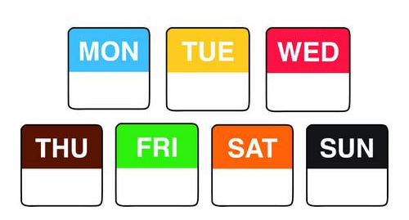
Day to Day Summary
Here is a summary of what was achieved on the seven days spent on our project:

Slide 4
Monday Summary
Decided on a website similar air B&B
Worked out what entities we would require for our ERD
Created a sitemap
Wireframes for mobile

Slide 5
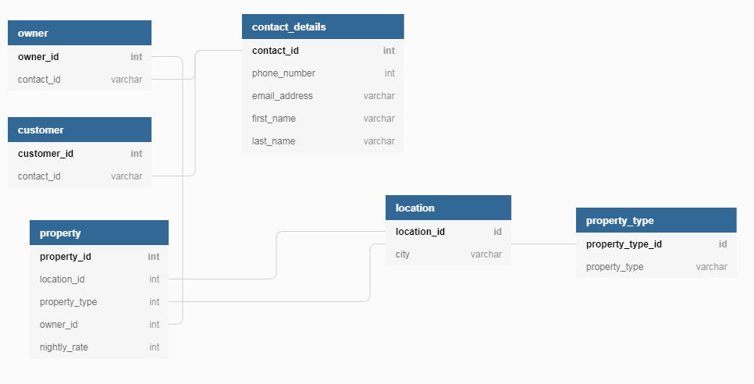
Original ERD

Slide 6
Tuesday Summary
Created database schema in a SQL file
Populated the database
Created class-diagram
Dekstop wireframe created
Finished Use-Case Diagram

Slide 7
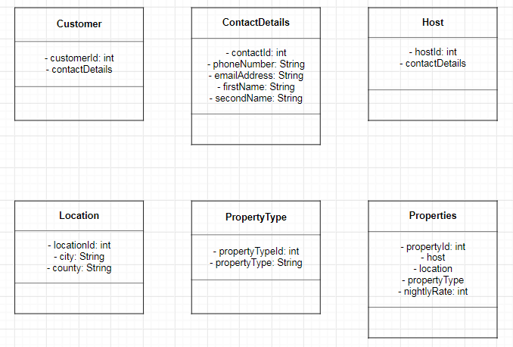
Class Diagram

Slide 8
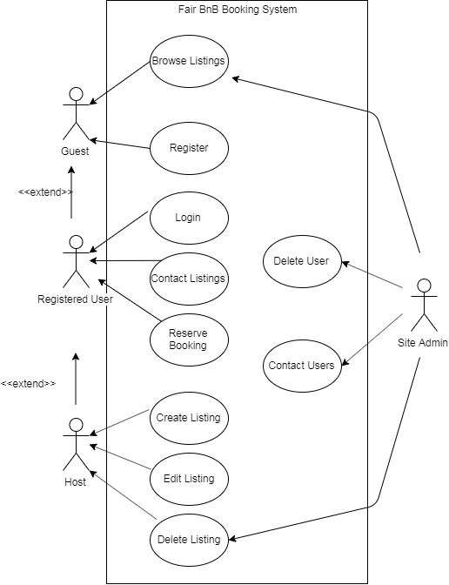

Slide 9
Wednesday Summary
Implemented the following entities:
ContactDetail
Location
Customer
Shiv decided on not implementing mapping straight away disregarding Sai’s suggestion
Completed class diagram
Decided we need a Reservation entity
Added Reservation to schema and populated with data

Slide 10
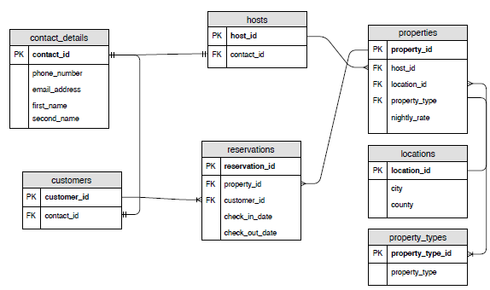
Updated ERD

Slide 11
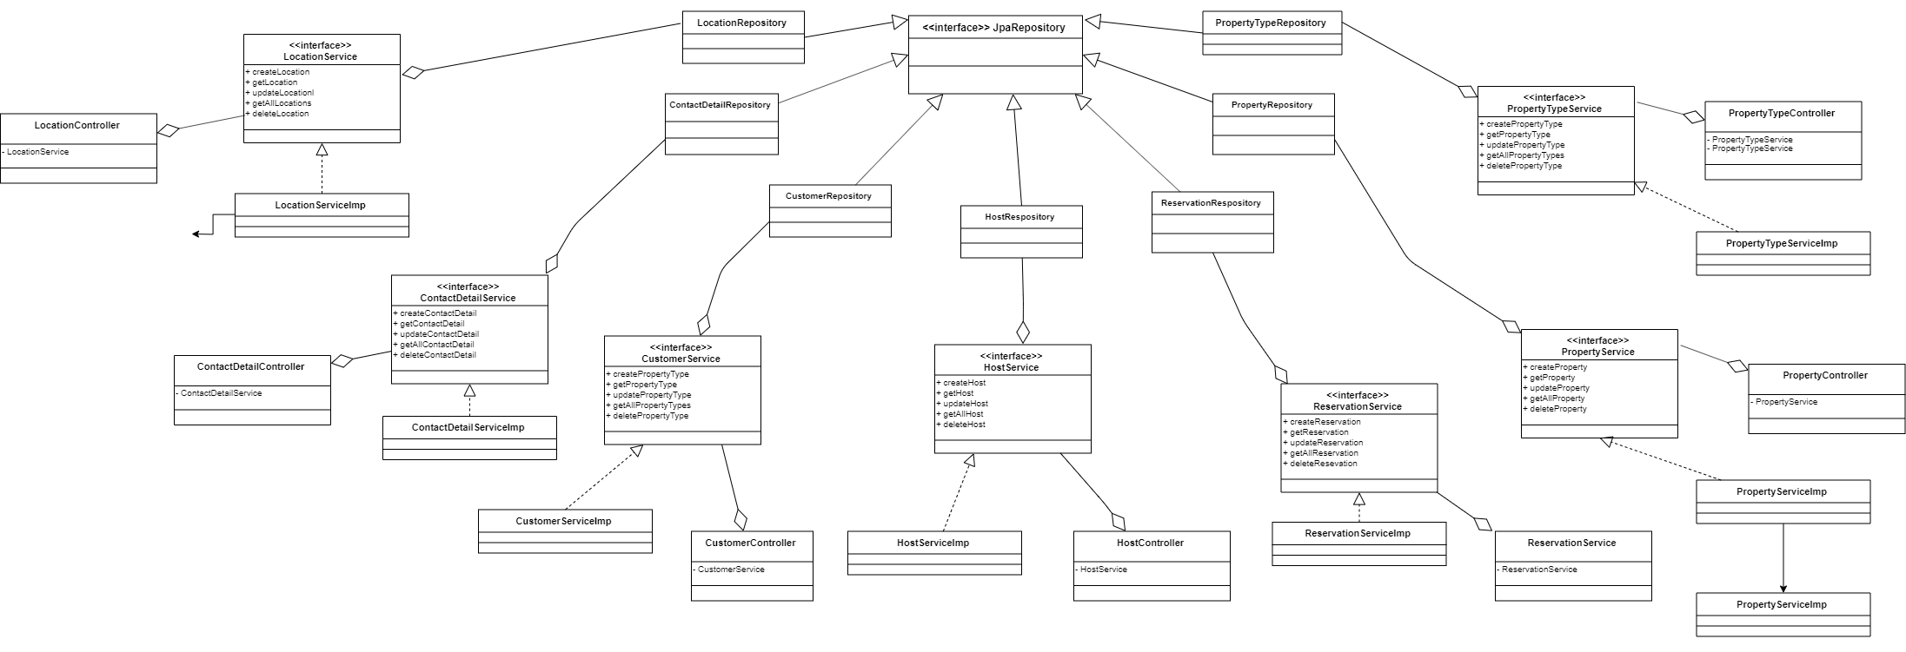
Class Diagram

Slide 12
Thursday Summary
Implemented every entity from our ERD
Created HTML pages and CSS but not implemented within the project yet

Slide 13
Friday Summary
Implemented the mappings between all entities
The HTML pages needed amending for the fields that were referenced

Slide 14
Saturday Summary
Shiv came to office to fix syntax issues in the HTML pages and controllers

Slide 15
Sunday/Monday Summary
Implemented the HTML and CSS from Iram’s work into the main project and get the pages running
Shiv implemented logging into the controllers which helped resolve post mapping issues
Finishing touches on project

Slide 16
Project demonstration

Slide 17
Retrospective - Iram

Slide 18
Retrospective – Shiv

Slide 19
Retrospective - Sai

